Slide 1
simCLR : A Simple Framework for Contrastive Learning of Visual Representations
Yuval Lavie

Slide 2
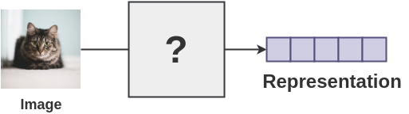
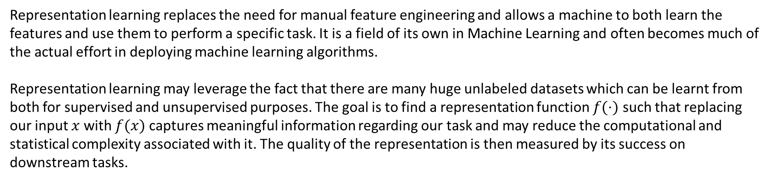
Representation Learning
Representation learning replaces the need for manual feature engineering and allows a machine to both learn the features and use them to perform a specific task. It is a field of its own in Machine Learning and often becomes much of the actual effort in deploying machine learning algorithms.
Representation learning may leverage the fact that there are many huge unlabeled datasets which can be learnt from both for supervised and unsupervised purposes. The goal is to find a representation function $f(⋅)$ such that replacing our input $x$ with $f(x)$ captures meaningful information regarding our task and may reduce the computational and statistical complexity associated with it. The quality of the representation is then measured by its success on downstream tasks.

Slide 3
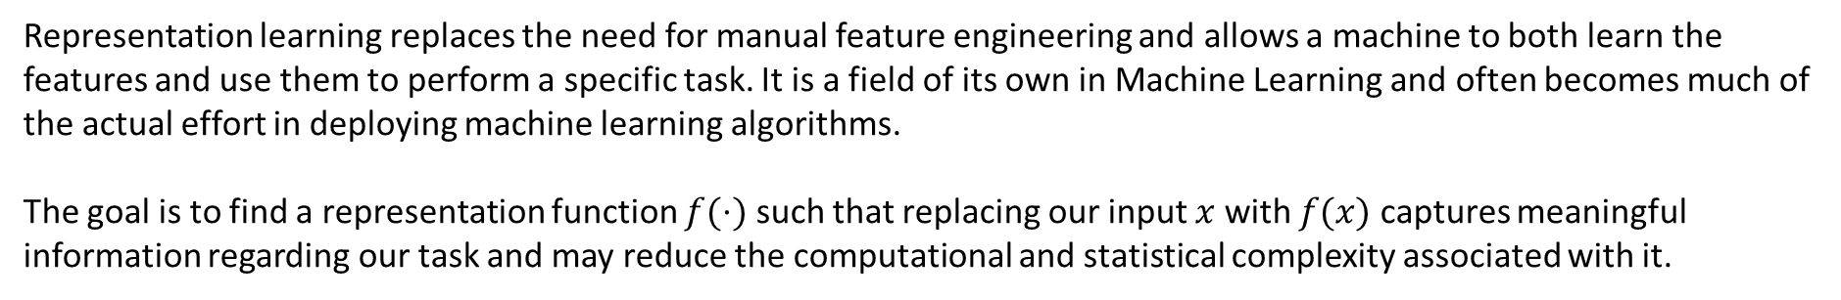
Representation Learning
Representation learning replaces the need for manual feature engineering and allows a machine to both learn the features and use them to perform a specific task. It is a field of its own in Machine Learning and often becomes much of the actual effort in deploying machine learning algorithms.
The goal is to find a representation function $f(⋅)$ such that replacing our input $x$ with $f(x)$ captures meaningful information regarding our task and may reduce the computational and statistical complexity associated with it.

Slide 4
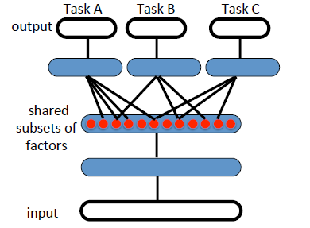
Uses of representations
Transfer learning is the ability of a learning algorithm to exploit commonalities between different learning tasks in order
to share statistical strength, and transfer knowledge across tasks. we hypothesize that representation learning algorithms have an advantage for such tasks because they learn representations that capture underlying factors, a subset of which may be relevant for each task, as illustrated in Figure 2. This hypothesis seems confirmed by several empirical results showing the strengths of representation learning algorithms in transfer learning scenarios.
Figure 1. Illustration of representation-learning discovering explanatory factors
(middle hidden layer, in red), some explaining the input (semi-supervised settings)
And some explaining the target for each task. Because these subsets overlap, sharing
of statistical strength helps generalization

Slide 5
Uses of representations
Model Complexity Reduction - For AI-tasks, such as vision and NLP, it seems hopeless to rely only on simple parametric models (such as linear models) because they cannot capture enough of the complexity of interest unless provided with the appropriate feature space. Assuming that pictures of dogs and cats are separable by a hyperplane may be too strict but their learnt representations may be separable.
Figure 2. Representations of the data are shown to be linearly separable

Slide 6
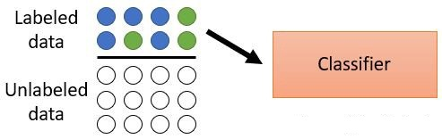
Uses of representations
Sample Complexity Reduction - A useful representation which allows us to learn a simpler function may suggest that our task can be learnt with fewer samples. Statistical Learning theory quantifies the requirement as a function of the VC-Dimension. Other analysis methods include Natarajan’s Dimension, Rademacher Complexity and PAC Bayesian learning.
We would like to make use of this theory to learn representations from a large set of unlabeled data and train our simple models on our small sets of labeled data.
Figure 3. Illustration of our dataset which consists of both labeled And unlabeled data. We learn our representations on the labeled data And then train a classifier on those representations instead of the original labeled data.

Slide 7
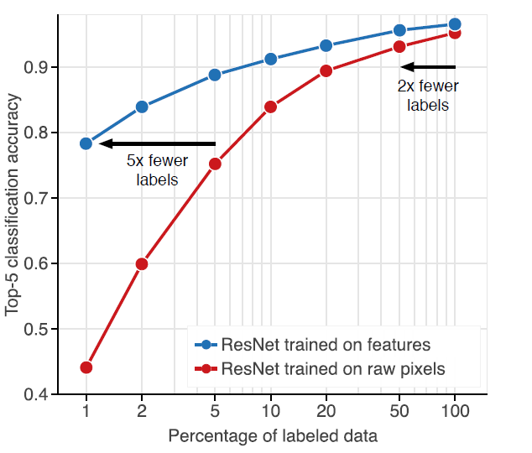
Representations in practice
Deep neural networks excel at perceptual tasks when labeled data are abundant, yet their performance degrades substantially when provided with limited supervision.
Figure 4. Depicting the change in accuracy of supervised and unsupervised
Classifiers when trained on decreasing amounts of labeled data. Unsupervised
Classifiers retain high accuracy even when trained on small datasets and can
Achieve competitive accuracy with significantly fewer labels (horizontal arrows).

Slide 8
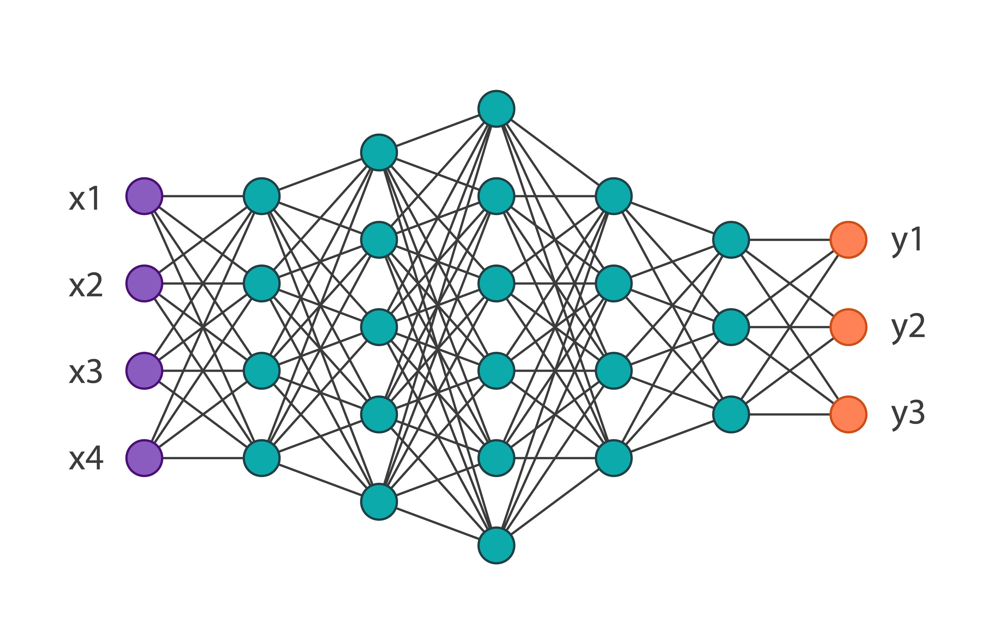
Supervised Representation
For images, a proof of existence for broadly useful representations is the output of the penultimate layer (the one before the softmax) of a network trained on the ImageNet dataset

Slide 9
Unsupervised Representation Learning
Unsupervised representation learning aims at extracting features representation from an unlabeled dataset for downstream tasks such as classification. An unsupervised representation learning model is typically learnt by solving a pretext task without supervised information. Trained model work as a feature extractor for supervised tasks.
Pretext Task: Pretext tasks are pre-designed tasks for systems to solve, features are learned by learning objective functions of pretext tasks.
Downstream Task: Downstream tasks are computer vision applications that are used to evaluate the quality of features learned by self-supervised learning. These applications can greatly benefit from the pretrained models when training data are scarce.

Slide 10
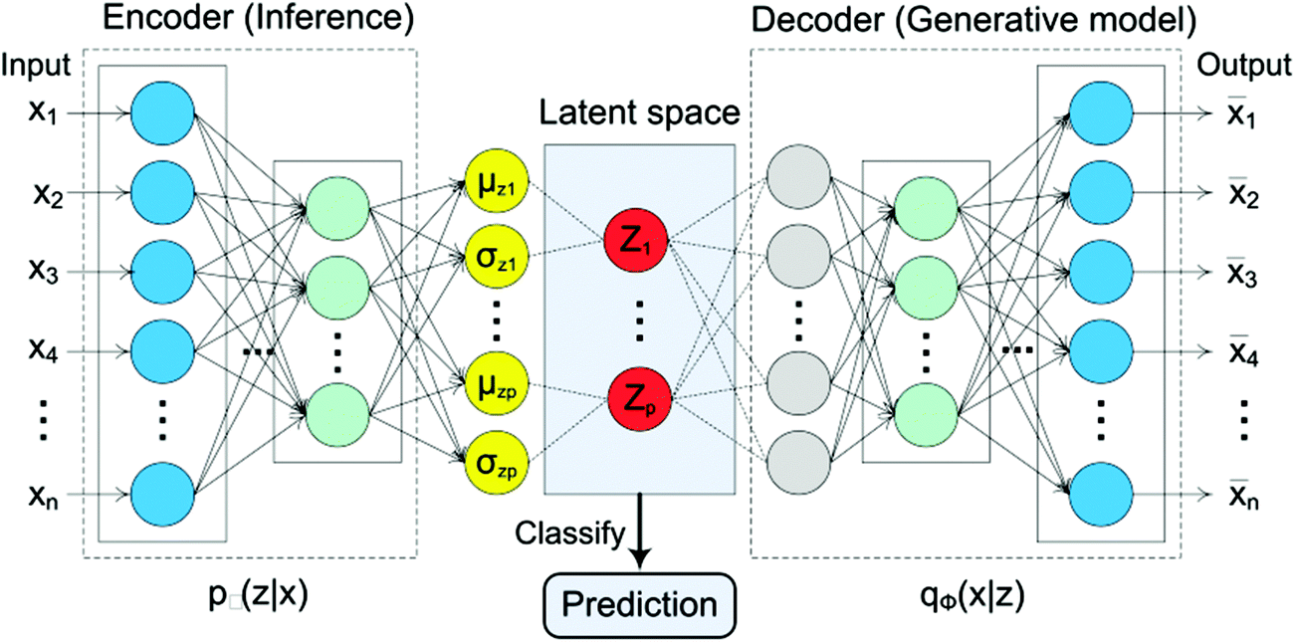
Unsupervised Representation
An auto-encoder extracts a meaningful low dimensional representation of the data avoiding the curse of dimensionality and reduces the computational complexity of a given task. A good representation may lead us to choosing a simpler decision model thus reducing the amount of labeled data required for a downstream task such as binary classification.

Slide 11
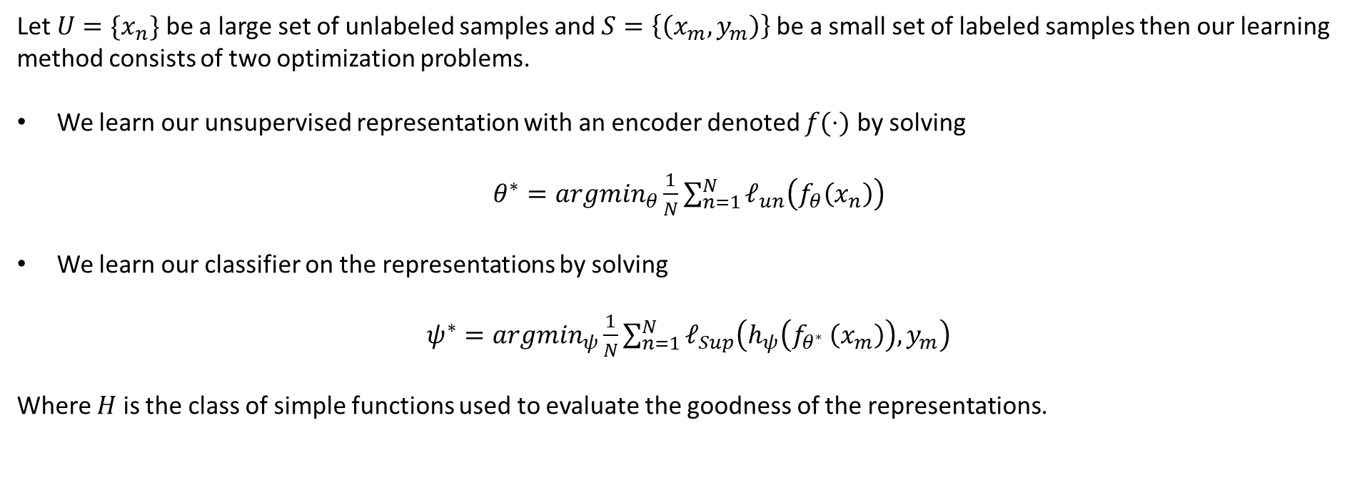
Learning and Evaluating
Let $U=\{x_{n}\}$ be a large set of unlabeled samples and $S=\left\{\left(x_{m},y_{m}\right)\right\}$ be a small set of labeled samples then our learning method consists of two optimization problems.
We learn our unsupervised representation with an encoder denoted $f(⋅)$ by solving
$θ^{∗}={argmin}_{θ}\frac{1}{N}\sum_{n=1}^{N}{ℓ_{un}\left(f_{θ}\left(x_{n}\right)\right)}$
We learn our classifier on the representations by solving
$ψ^{∗}={argmin}_{ψ}\frac{1}{N}\sum_{n=1}^{N}{ℓ_{Sup}\left(h_{ψ}\left(f_{θ^{∗} }\left(x_{m}\right)\right),y_{m}\right)}$
Where $H$ is the class of simple functions used to evaluate the goodness of the representations.

Slide 12
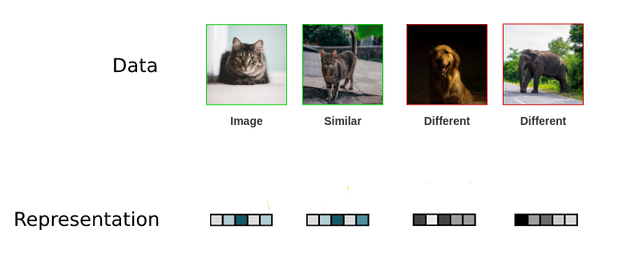
CURL
Contrastive unsupervised representation Learning is a method of learning representations which respect similarity: leveraging availability of “similar” and “dis-similar” data points. The learner then forces the similarity score of representations of similar samples with each other to be higher on average than with dissimilar samples by minimizing a contrastive loss.
Similar representations
Dissimilar representations

Slide 13
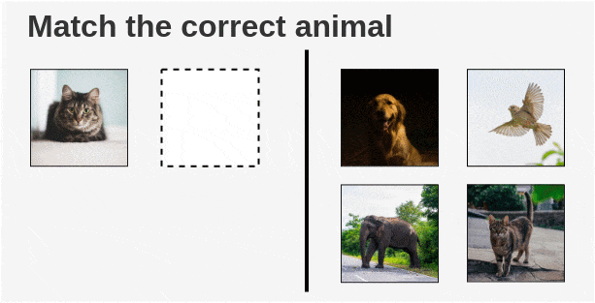
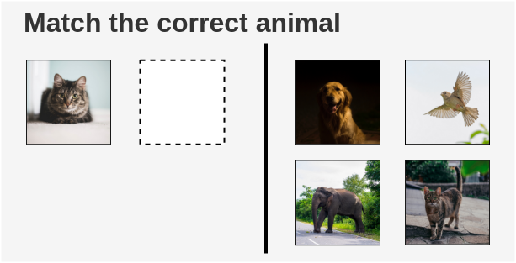
Intuition of Contrastive Learning
The way a child would solve it is by looking at the cat at the left side and search for a cat on the right side. Thus learning to contrast the cat from other animals and develop features for recognizing cats by similarity.

Slide 14
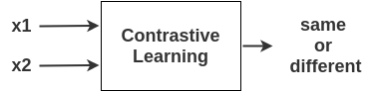
Learning by contrasting
Such exercises were prepared for the child to be able to recognize an object and contrast that to other objects. Can we teach machines in a similar manner?

Slide 15
CURL
Contrastive unsupervised representation Learning is a method of learning representations which respect similarity: leveraging availability of “similar” and “dis-similar” data points. The learner then forces the similarity score of representations of similar samples with each other to be higher on average than with dissimilar samples by minimizing a contrastive loss.
While it seems intuitive that minimizing such loss functions should lead to representations that capture ‘similarity,’
formally it is unclear why the learned representations should do well on downstream linear classification tasks – their somewhat mysterious success is often treated as an obvious consequence. To analyze this success, a framework must connect ‘similarity’ in unlabeled data with the information that is implicitly present in downstream tasks such as classification.
Recent attempts to explain this relation and to bound the loss functions and produce guarantees are based on Rademacher complexity and the PAC-Bayes frameworks.

Slide 16
Learning by contrasting
Present a simple and efficient framework to use unlabeled image data to learn visual representations which respect a measure of similarity between images. This representation should reduce the requirements for labeled data on downstream tasks such as classification and improve their performance.

Slide 17
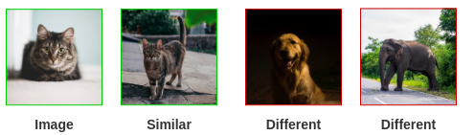
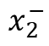
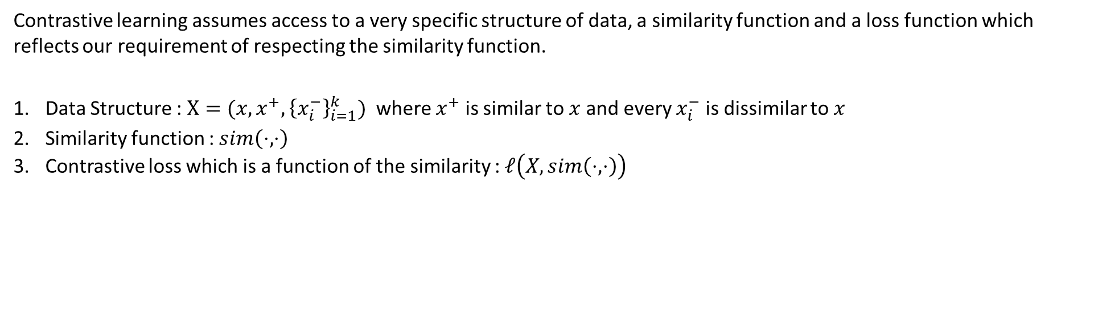
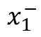
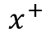
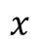
Framework for Contrastive Learning
Contrastive learning assumes access to a very specific structure of data, a similarity function and a loss function which reflects our requirement of respecting the similarity function.
Data Structure : $X=(x,x^{+},{\left\{x_{i}^{−}\right\}}_{i=1}^{k})$ where $x^{+}$ is similar to $x$ and every $x_{i}^{−}$ is dissimilar to $x$
Similarity function : $sim\left(⋅,⋅\right)$
Contrastive loss which is a function of the similarity : $ℓ\left(X,sim\left(⋅,⋅\right)\right)$
$$x$$
$$x^{+}$$
$$x_{1}^{−}$$
$$x_{2}^{−}$$

Slide 18
Why should it work ?
While it seems intuitive that minimizing such loss functions should lead to representations that capture ‘similarity,’
formally it is unclear why the learned representations should do well on downstream linear classification tasks – their somewhat mysterious success is often treated as an obvious consequence. To analyze this success, a framework must connect ‘similarity’ in unlabeled data with the information that is implicitly present in downstream tasks such as classification.
Recent literature has attempted to relate the success of their methods to maximization of mutual information between latent representations. However, it is not clear if the success of contrastive approaches is determined by mutual information or by the specific form of the contrastive loss.

Slide 19
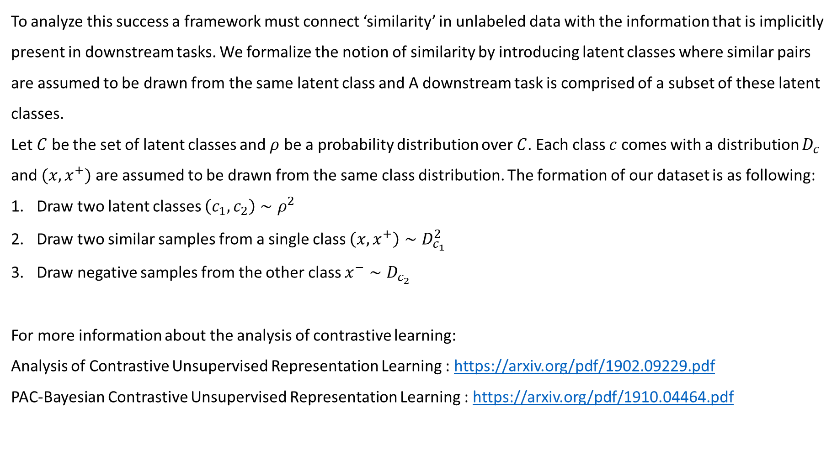
Framework Analysis
To analyze this success a framework must connect ‘similarity’ in unlabeled data with the information that is implicitly present in downstream tasks. We formalize the notion of similarity by introducing latent classes where similar pairs are assumed to be drawn from the same latent class and A downstream task is comprised of a subset of these latent classes.
Let $C$ be the set of latent classes and $ρ$ be a probability distribution over $C$. Each class $c$ comes with a distribution $D_{c}$ and $(x,x^{+})$ are assumed to be drawn from the same class distribution. The formation of our dataset is as following:
Draw two latent classes $\left(c_{1},c_{2}\right)∼ρ^{2}$
Draw two similar samples from a single class $\left(x,x^{+}\right)∼D_{c_{1}}^{2}$
Draw negative samples from the other class $x^{−}∼D_{c_{2}}$
For more information about the analysis of contrastive learning:
Analysis of Contrastive Unsupervised Representation Learning : https://arxiv.org/pdf/1902.09229.pdf
PAC-Bayesian Contrastive Unsupervised Representation Learning : https://arxiv.org/pdf/1910.04464.pdf

Slide 20
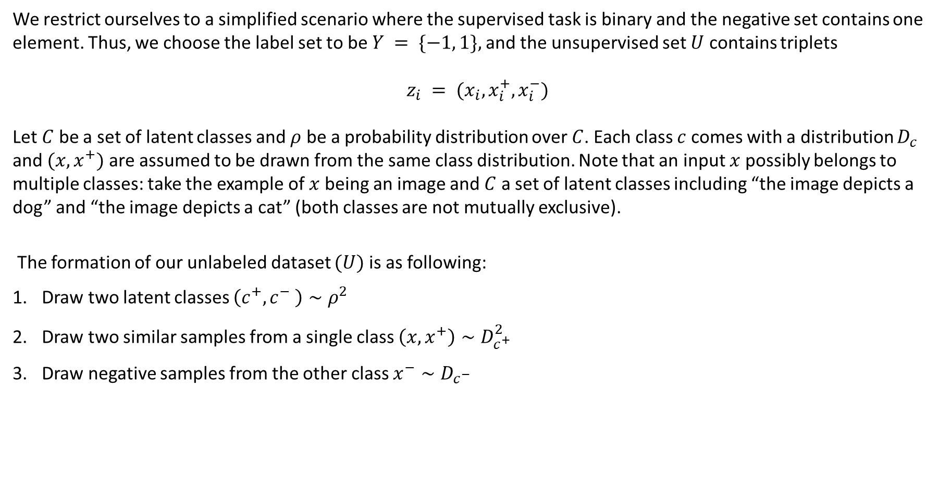
Simple Analysis
We restrict ourselves to a simplified scenario where the supervised task is binary and the negative set contains one element. Thus, we choose the label set to be $Y = \{−1, 1\},$and the unsupervised set $U$ contains triplets
$$z_{i} = (x_{i}, x_{i}^{+},x_{i}^{−})$$
Let $C$ be a set of latent classes and $ρ$ be a probability distribution over $C$. Each class $c$ comes with a distribution $D_{c}$ and $(x,x^{+})$ are assumed to be drawn from the same class distribution. Note that an input $x$ possibly belongs to multiple classes: take the example of $x$ being an image and$C$a set of latent classes including “the image depicts a dog” and “the image depicts a cat” (both classes are not mutually exclusive).
The formation of our unlabeled dataset $(U)$ is as following:
Draw two latent classes $\left(c^{+},c^{−} \right)∼ρ^{2}$
Draw two similar samples from a single class $\left(x,x^{+}\right)∼D_{c^{+}}^{2}$
Draw negative samples from the other class $x^{−}∼D_{c^{−}}$

Slide 21
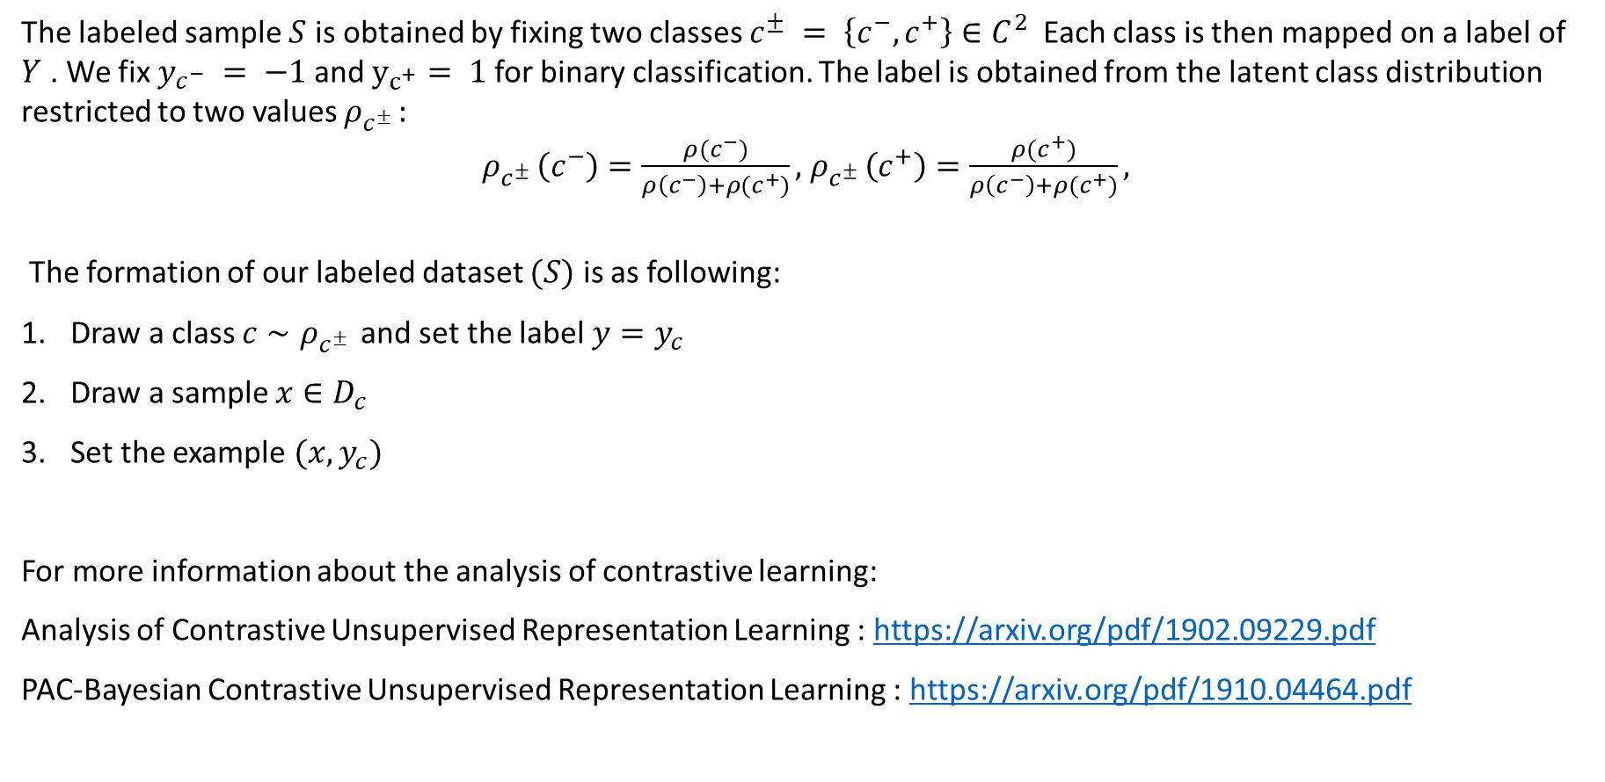
Analysis continued
The labeled sample $S$ is obtained by fixing two classes $c^{±} = \left\{c^{−}, c^{+}\right\}∈C^{2}$Each class is then mapped on a label of $Y$ . We fix $y_{c^{−}} = −1$and $y_{c^{+}}= 1$for binary classification. The label is obtained from the latent class distribution
restricted to two values $ρ_{c^{± }}:$
$ρ_{c^{± }}\left(c^{−}\right)=\frac{ρ(c^{−})}{ρ\left(c^{−}\right)+ρ(c^{+})},$ $ρ_{c^{± }}\left(c^{+}\right)=\frac{ρ(c^{+})}{ρ\left(c^{−}\right)+ρ(c^{+})},$
The formation of our labeled dataset $(S)$ is as following:
Draw a class $c∼ρ_{c^{± }}$and set the label $y=y_{c}$
Draw a sample $x∈D_{c}$
Set the example $(x,y_{c})$
For more information about the analysis of contrastive learning:
Analysis of Contrastive Unsupervised Representation Learning : https://arxiv.org/pdf/1902.09229.pdf
PAC-Bayesian Contrastive Unsupervised Representation Learning : https://arxiv.org/pdf/1910.04464.pdf

Slide 22
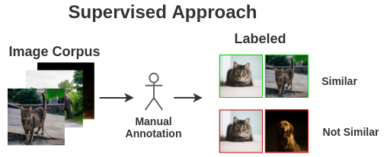
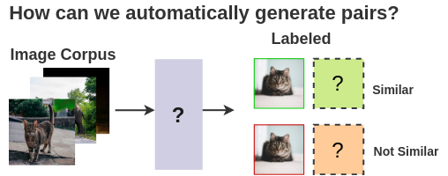
Assumptions and Intuitions aside..
Gathering unlabeled data is certainly easier than gathering labeled data, but how do we get access to data with the specific structure needed for contrastive learning ? If we ask humans to manually find similarities between samples we may as well just ask them to label the data and use supervised methods for classification.
Instead we would like to be able to automatically find the structure or to generate this structure ourselves.
If we decide to automatically find the structure, then we need to find a representation and similarity function which the computer can understand.

Slide 23
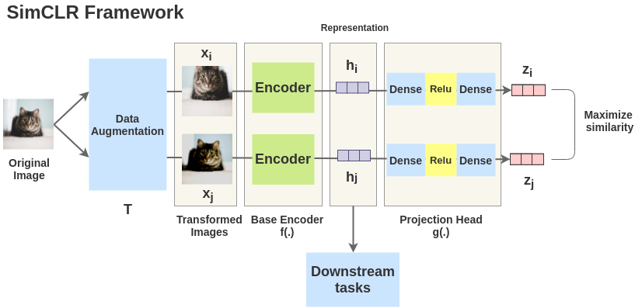
SimCLR : Learning visual representations
SimCLR is a simple framework for contrastive learning of visual representations which not only outperforms previous work on the subject but is also much simpler and requires no specialized architectures nor a memory bank. SimCLR learns representations by maximizing agreement between differently augmented views of the same image via a contrastive loss in the latent space.

Slide 24
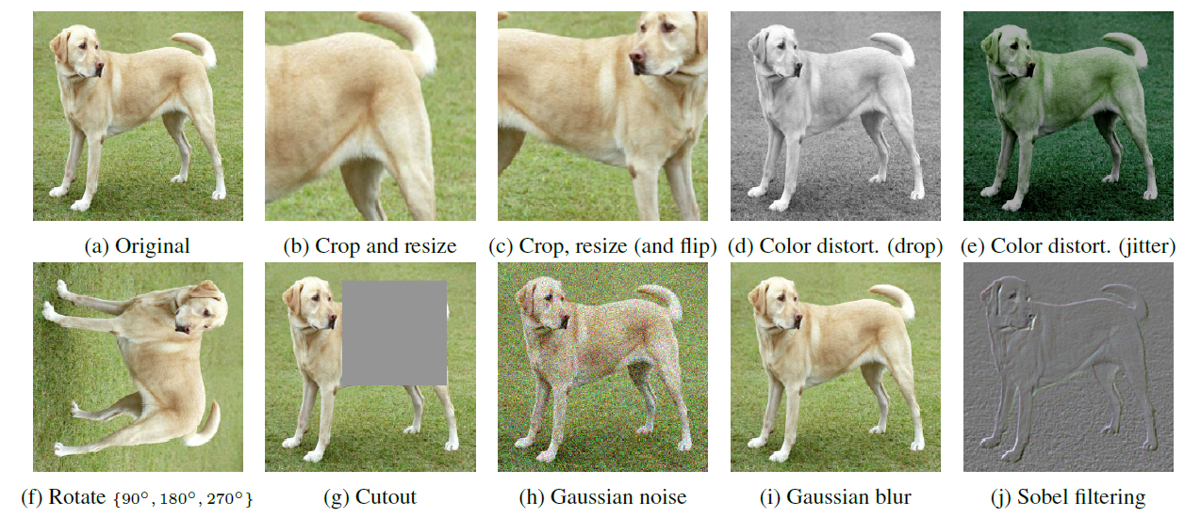
Augmentations

Slide 25

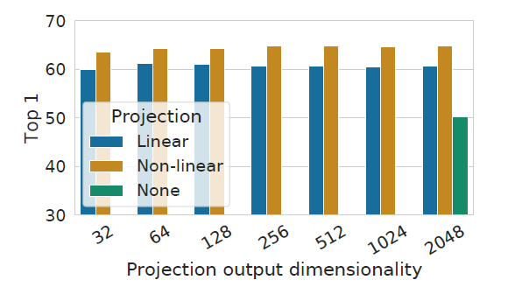
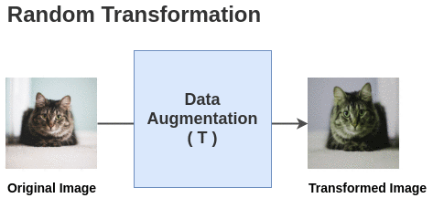
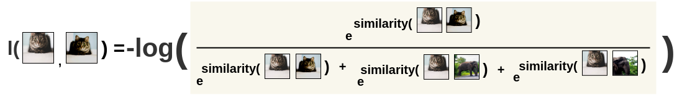
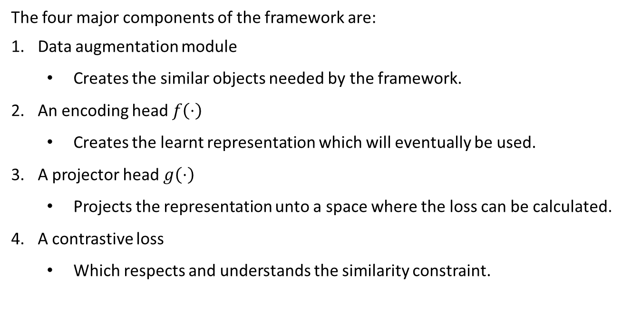
SimCLR : Components
The four major components of the framework are:
Data augmentation module
Creates the similar objects needed by the framework.
An encoding head $f\left(⋅\right)$
Creates the learnt representation which will eventually be used.
A projector head $g\left(⋅\right)$
Projects the representation unto a space where the loss can be calculated.
A contrastive loss
Which respects and understands the similarity constraint.

Slide 26
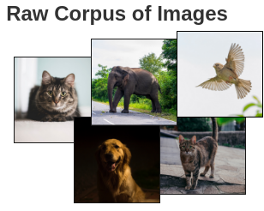
Step by step
We have a large data set of unlabeled images and would like to learn a contrastive representation

Slide 27
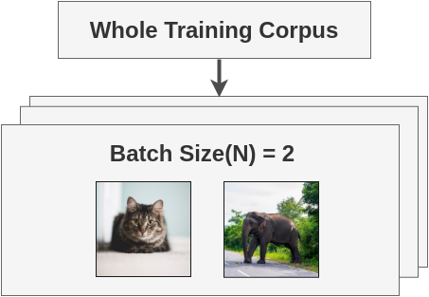
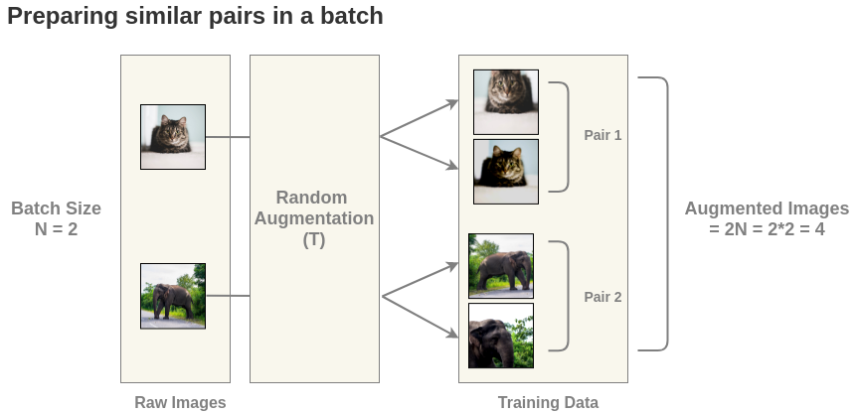
Step by step
We generate a batch of N images and apply our transformations on each image to receive 2N augmented images

Slide 28
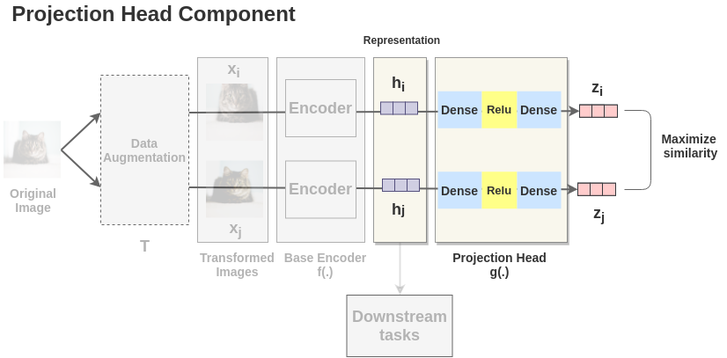
Step by step
We pass the augmented images through the encoder $f(⋅)$ and the projection head $g(f\left(⋅\right))$

Slide 29
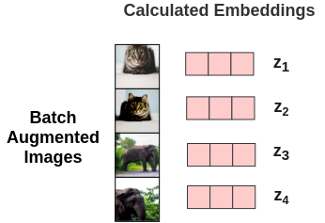
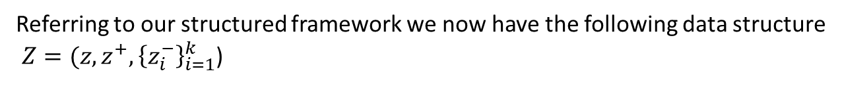
Step by step
Referring to our structured framework we now have the following data structure
$Z=(z,z^{+},{\left\{z_{i}^{−}\right\}}_{i=1}^{k}$)

Slide 30
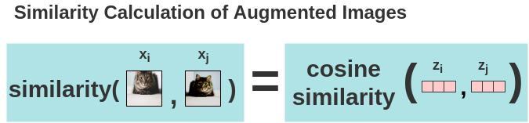
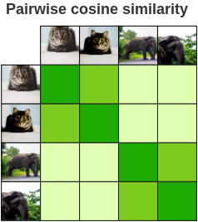
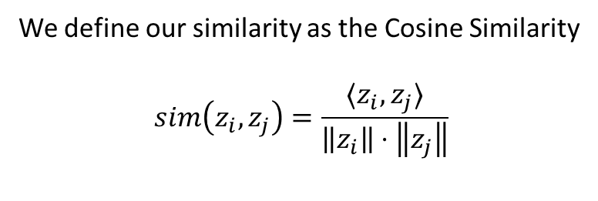
Step by step
We define our similarity as the Cosine Similarity
$$sim\left(z_{i},z_{j}\right)=\frac{⟨z_{i},z_{j}⟩}{\left\|z_{i}\right\|⋅\left\|z_{j}\right\|}$$
And hope that in the ideal case the similarities will follow our logic

Slide 31

Simulation

Slide 32
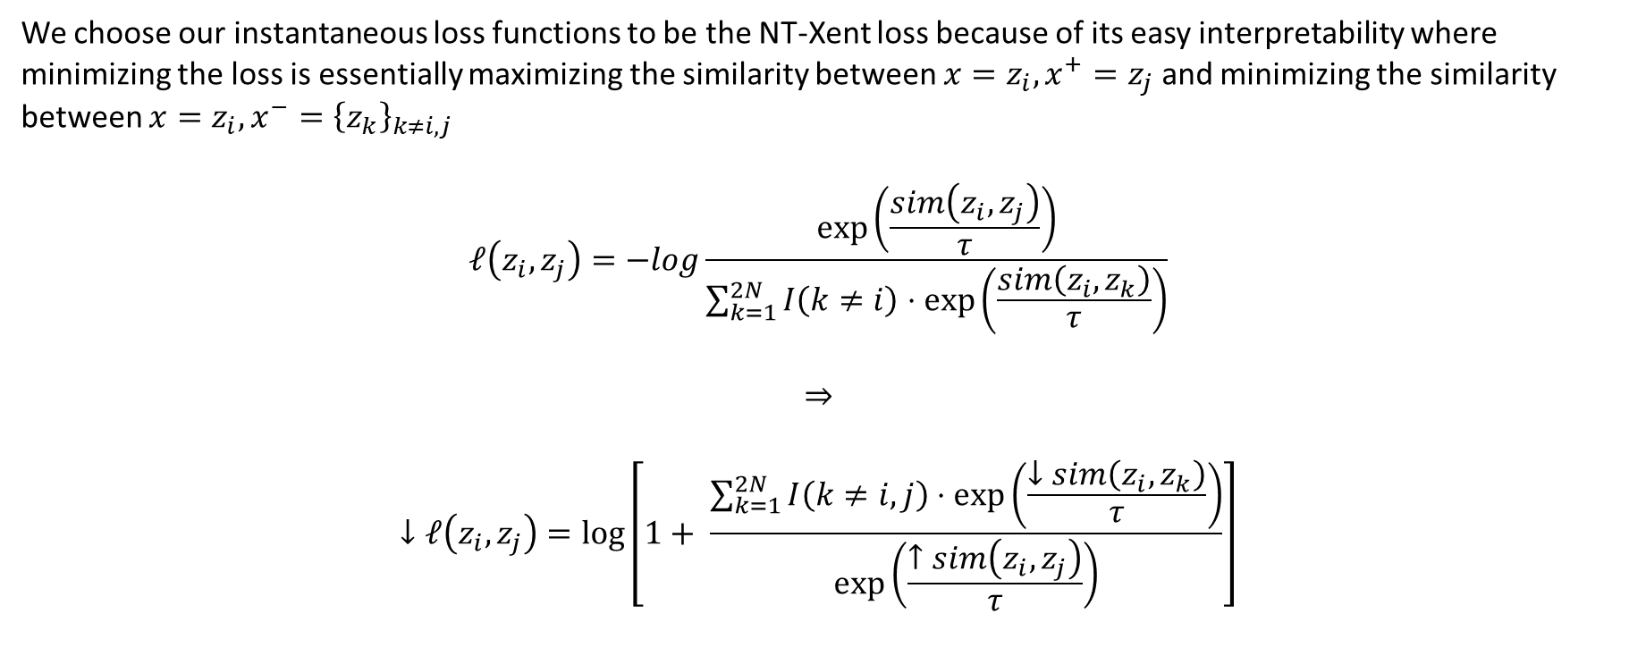
NT-Xent: Normalized Temperature-Scaled Cross Entropy
We choose our instantaneous loss functions to be the NT-Xent loss because of its easy interpretability where minimizing the loss is essentially maximizing the similarity between ${x=z}_{i},x^{+}=z_{j}$ and minimizing the similarity between $x=z_{i},x^{−}={\left\{z_{k}\right\}}_{k≠i,j}$
$$ℓ\left(z_{i},z_{j}\right)=−log\frac{\exp\left(\frac{sim\left(z_{i},z_{j}\right)}{τ}\right)}{\sum_{k=1}^{2N}{I\left(k≠i\right)⋅\exp\left(\frac{sim\left(z_{i},z_{k}\right)}{τ}\right)}}$$
$$⇒$$
$$↓ℓ\left(z_{i},z_{j}\right)=\log\left[1+ \frac{\sum_{k=1}^{2N}{I\left(k≠i,j\right)⋅\exp\left(\frac{↓sim\left(z_{i},z_{k}\right)}{τ}\right)}}{\exp\left(\frac{↑sim\left(z_{i},z_{j}\right)}{τ}\right)}\right]$$

Slide 33
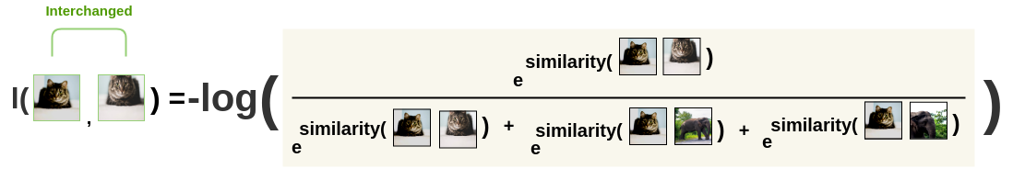
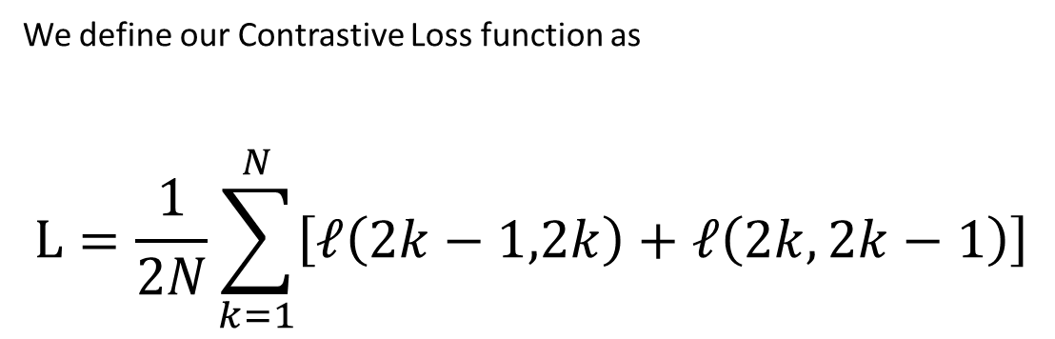
Training the network
We define our Contrastive Loss function as
$$L=\frac{1}{2N}\sum_{k=1}^{N}{\left[ℓ\left(2k−1,2k\right)+ℓ\left(2k,2k−1\right)\right]}$$

Slide 34
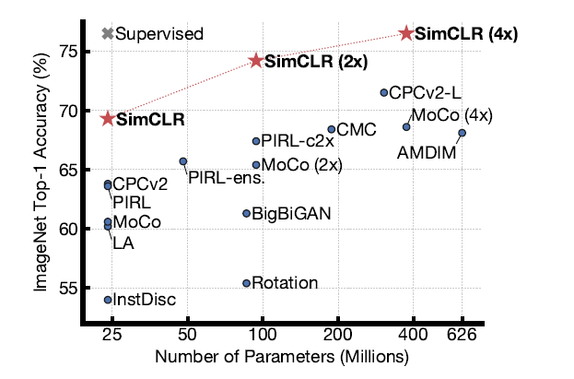
Results - Paper
Figure 5. ImageNet Top-1 accuracy of linear classifiers trained on
representations learned with different self-supervised methods
(pretrained on ImageNet). Gray cross indicates supervised
ResNet-50. Our method, SimCLR, is shown in bold.

Slide 35
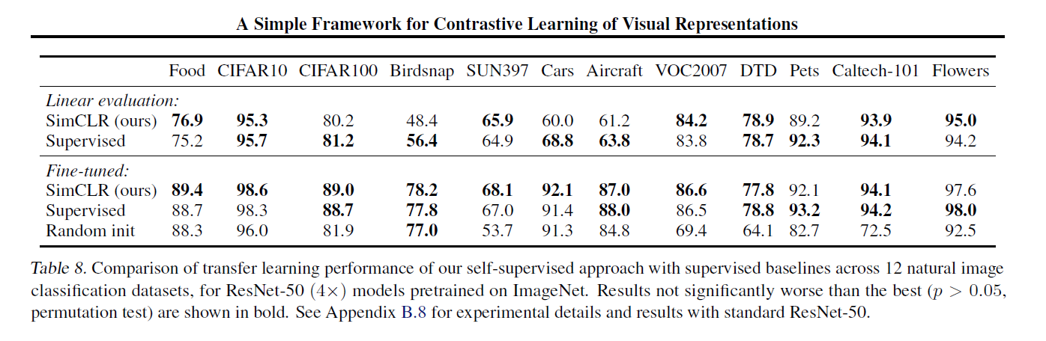
Results - Paper

Slide 36
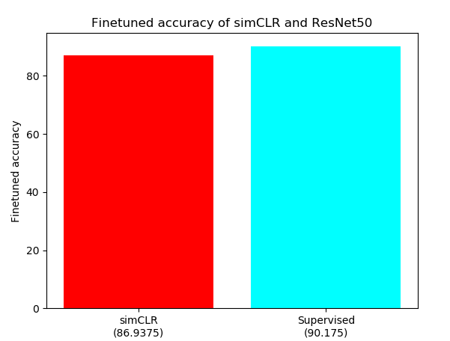
Real results
A simplified implementation that uses googles pre-trained weights and a fine-tuned multiclass logistic classifier on the STL-10 data set
Shows that simCLR provides competitive results with the supervised counterpart using the ResNet-50 (1x) encoding head.
Figure 6. Top-1 accuracy of linear classifiers fine-tuned on top of representations
learnt by simCLR and by a supervised method. Code for result recreation can be
found at : https://github.com/yuvallavie/simCLR

Slide 37
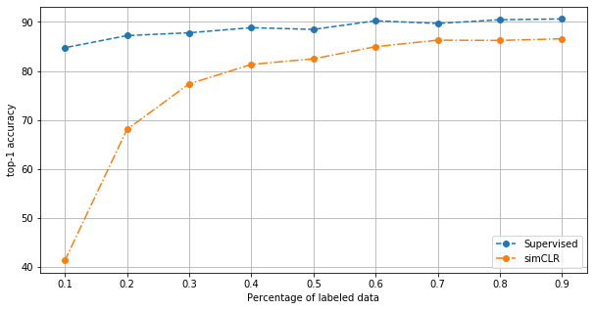
Real results
We hypothesized that unsupervised methods should suffer less from the lack
Of unlabeled data to fine tune on.. But what happens in reality ?
Figure 1. Depicting the change in accuracy of supervised and unsupervised
Classifiers when trained on decreasing amounts of labeled data. Unsupervised
Classifiers retain high accuracy even when trained on small datasets and can
Achieve competitive accuracy with significantly fewer labels (horizontal arrows).
Figure 7. Depicting the change in accuracy in linear classifiers
Finetuned on decreasing amounts of representations produced by simCLR
and by a supervised ResNet pre-trained on ImageNet. simCLR provides competitive
results but suffers more than its supervised counterpart.

Slide 38
Conclusions
Supervised methods are still much better at creating meaningful representations and I disagree with many papers that try to compete with supervised methods. The main issue is the lack of labeled data.
The success of this framework rekindles interest in self-supervised and unsupervised pretraining methods as seen by the many new articles released on this subject recently.
simCLR’s results show that the complexity of previous methods for self-supervised learning is not necessary and generally opens room for thought about how complex a model should be.
Theoretical understanding of contrastive learning is lacking, results are treated to an obvious consequence. New theoretical analysis based on PAC-Bayes has emerged recently and has already allowed the creation of new contrastive algorithms based on its bounds.
Even though its simple to implement, the framework requires extensive computing power. It benefits from larger batch sizes and longer training.
It opens room for thought about more methods which mimic the human brain.

Slide 39
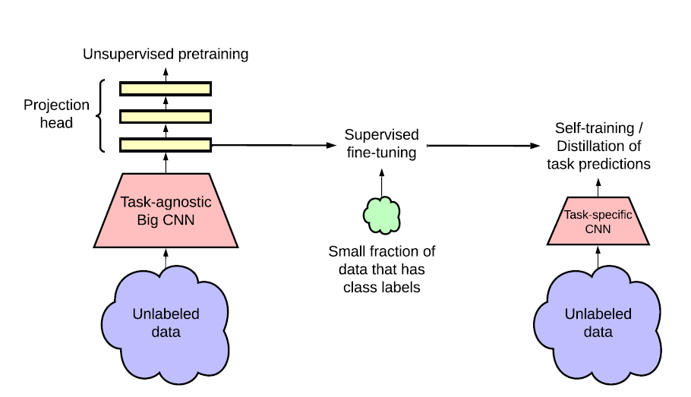
What’s next ?
SimCLRv2 is an improvement on SimCLR which explores different encoding heads, projection heads and different training techniques. A major change is the way unlabeled data is used twice. Once to generate task-agnostic representations and once again to distill the representations towards a specific task.
Figure 7. Depicts the process of creating preliminary task-agnostic
Representations and then finetuning them towards task-specific
Representations with the SimCLRv2 method.

Slide 40
References
A Simple Framework for Contrastive Learning of Visual Representations (Original paper)
https://arxiv.org/pdf/2002.05709.pdf
Big Self-Supervised Models are Strong Semi-Supervised Learners (simCLR Version 2)
https://arxiv.org/pdf/2002.05709.pdf
Representation Learning: A Review and New Perspectives
https://arxiv.org/pdf/1206.5538.pdf
Google’s GitHub for both versions of the framework (TensorFlow)
https://github.com/google-research/simclr
A PyTorch implementation by sthalles
https://github.com/sthalles/SimCLR

